Slide 1
Steph Chadwick
RE:Connect Teacher Fellowship Programme
Curriculum Project Feedback

Slide 2
My Project…
Climate Stories

Slide 3
Climate Stories
The Earth’s Story – What is the earth’s climate story?
Stories of Origin - What do we learn about the value of earth from creation stories?
Stories of Inspiration - How can stories inspire climate action?
My Climate Story – What is my own climate story?

Slide 4
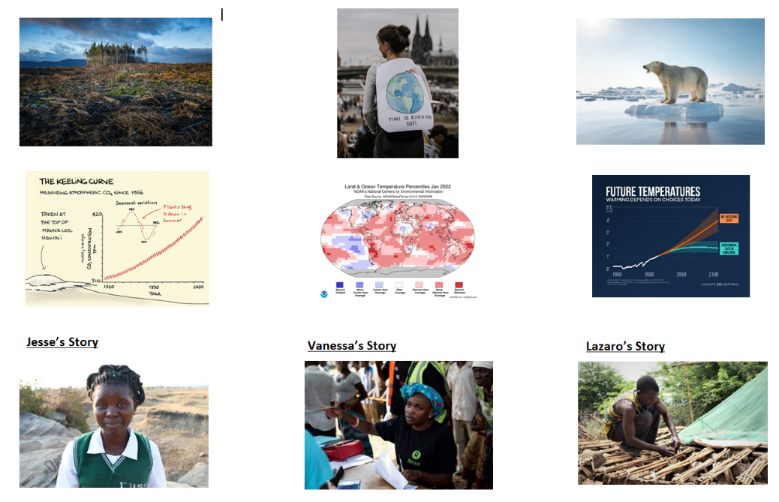
1 - The Earth’s Story
Opinion Statements starter – e.g.
I can explain fully what the term ‘Climate Change’ means.
The earth’s climate is changing and we need to do something to stop it.
I love planet earth.
Sources – what story do they tell?
What is the Earth’s story?

Slide 5
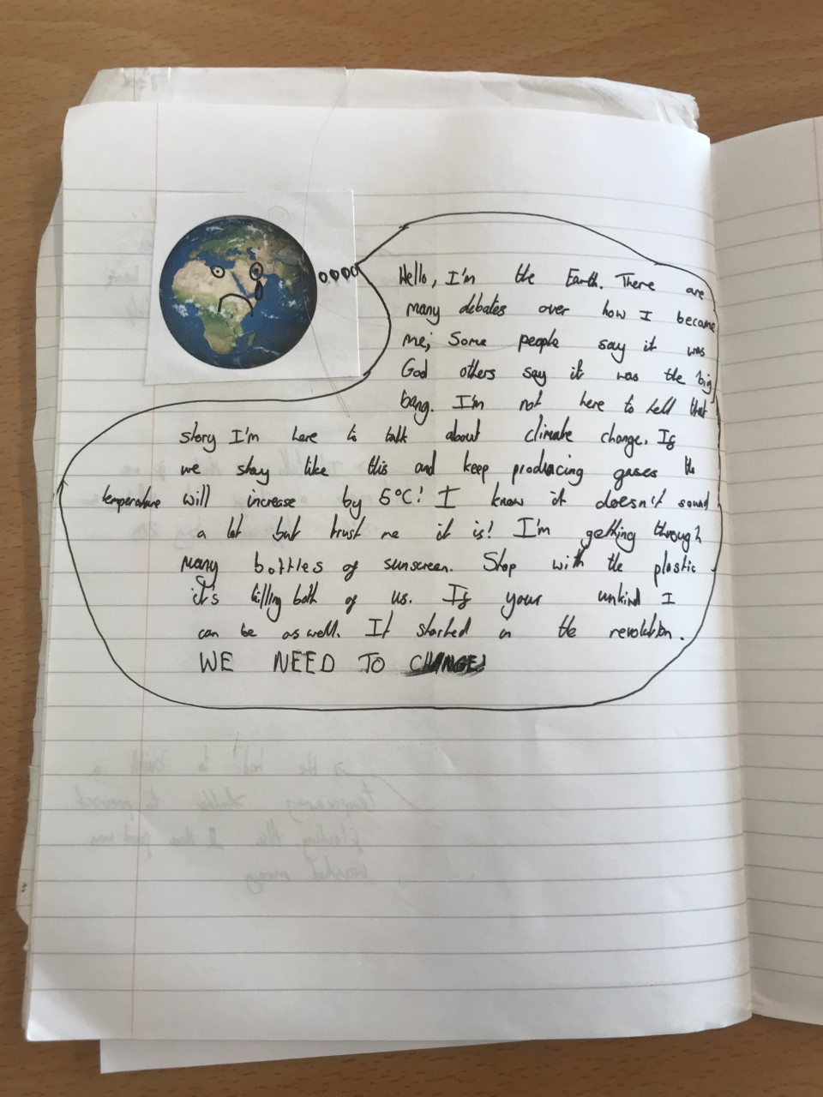
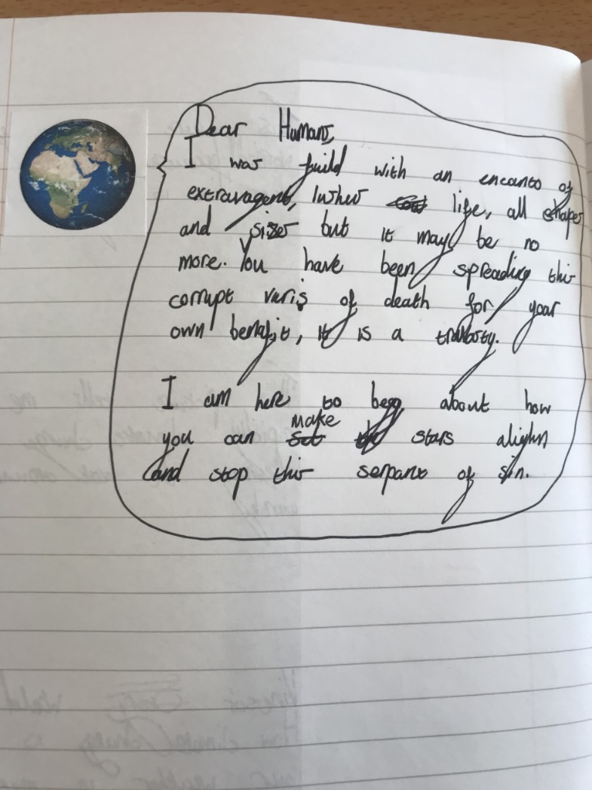
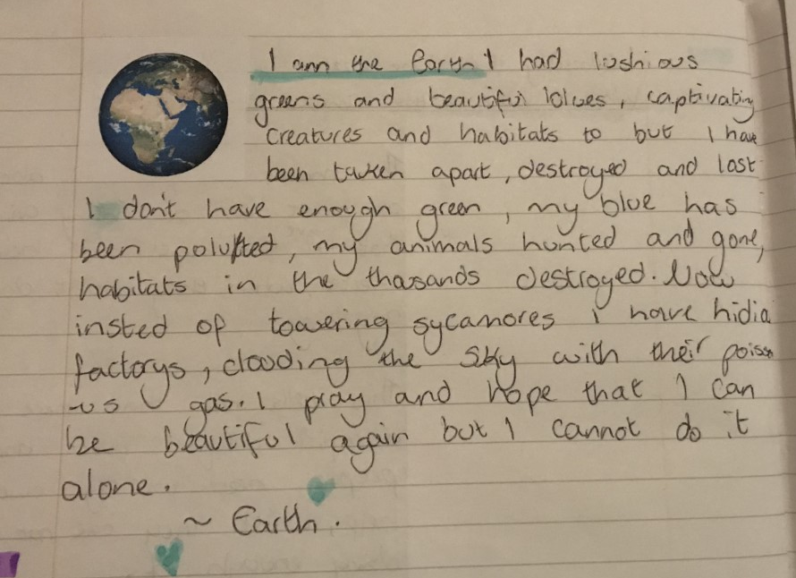
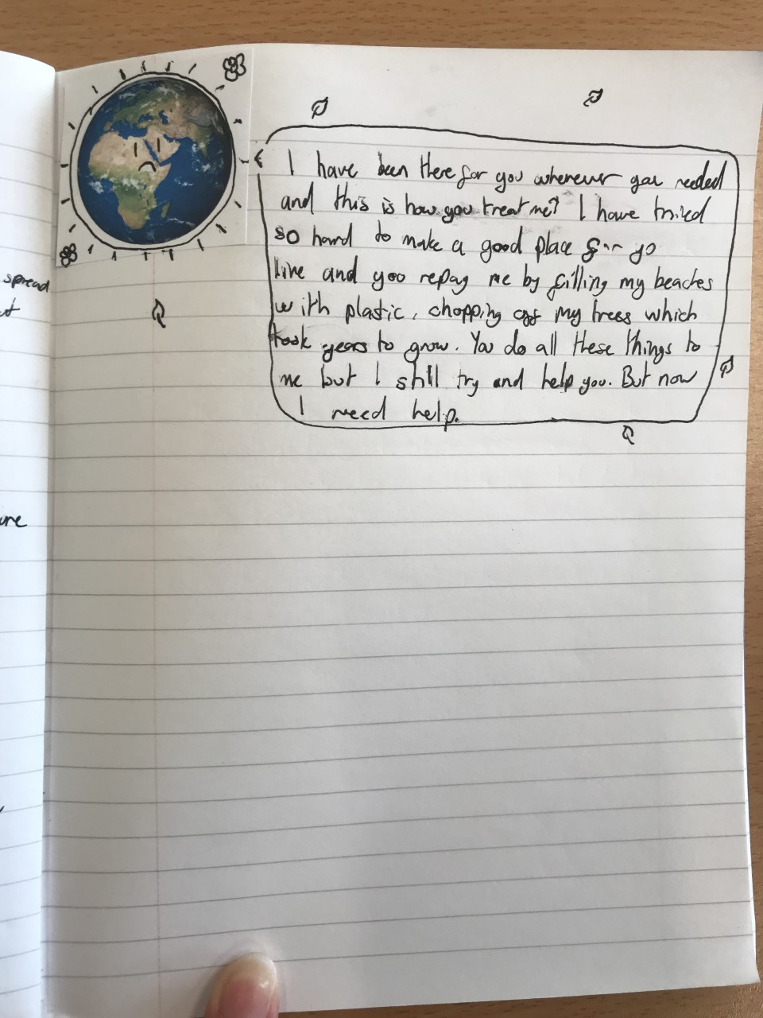

Slide 6
2 - Stories of Origin
Introduced Scriptural Reasoning
Went outside and sat in a circle in the shade of a tree
2 passages – Genesis 1 / The Scientific Narrative
How do the stories lead to an attitude of valuing the earth?
- Comparative claims of value

Slide 7
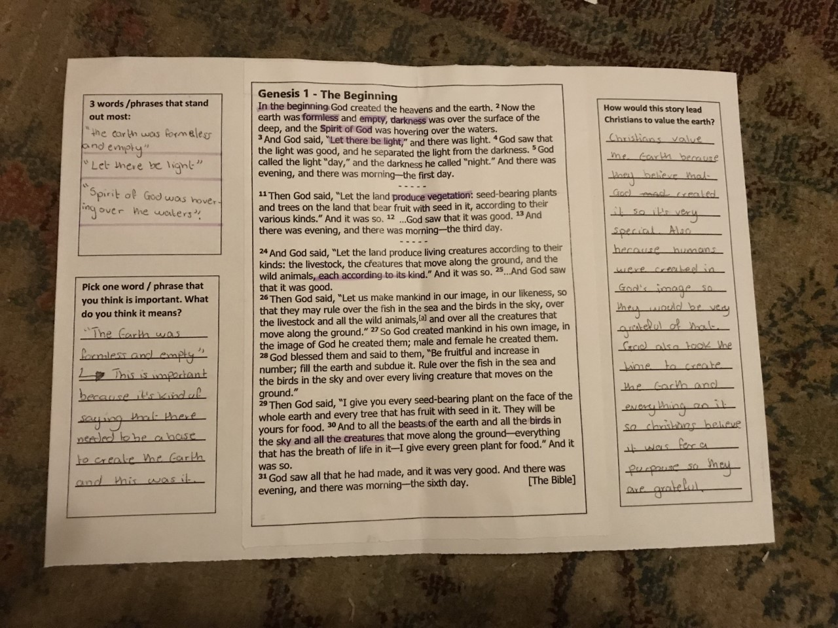
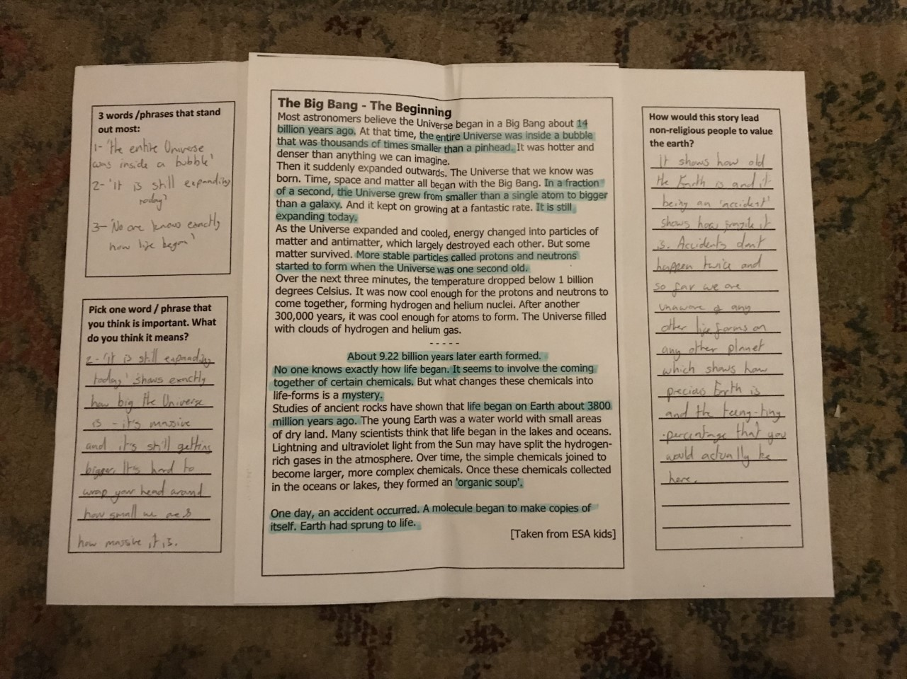

Slide 8
Stories of Inspiration
Poem starter – ‘The Tree’
Faith / non-faith activists and their stories
What inspires these people?
Leaves of inspiration

Slide 9
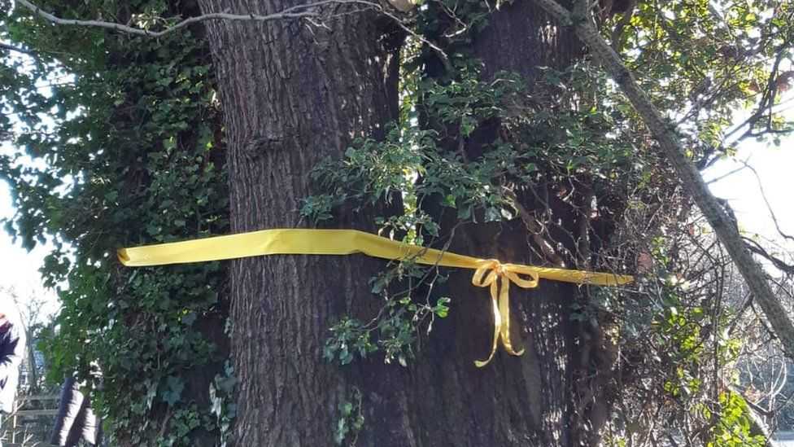
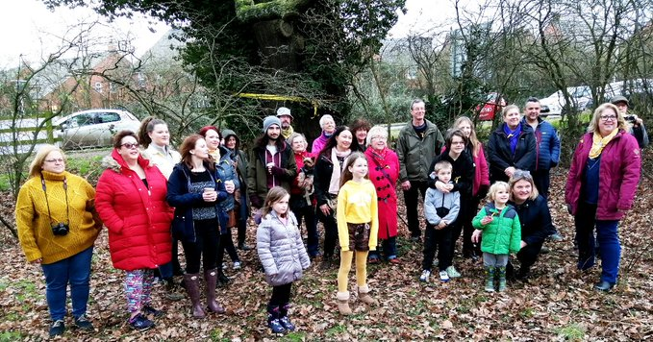

The Tree

Slide 10
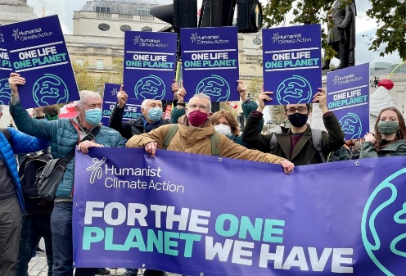
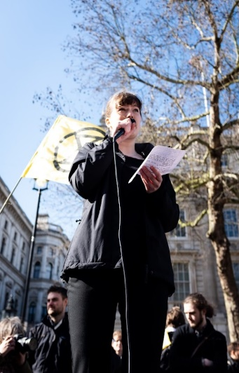
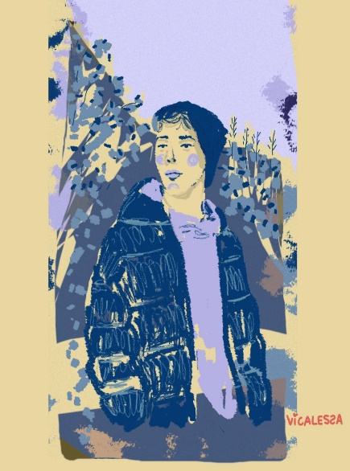
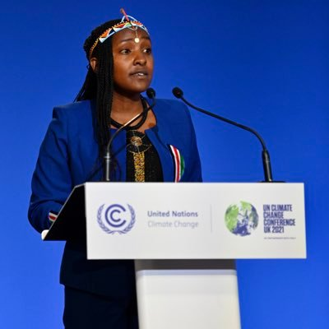
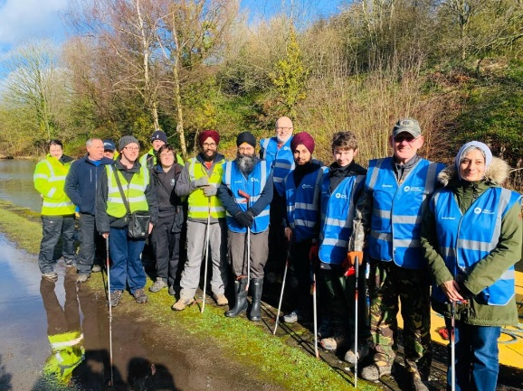
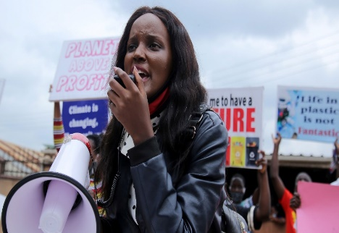
Read through your stories:
What do you think inspired each person to take action?
Are there similarities / differences between them?
Why do you find them inspiring?

Slide 11

Pick one of the people you have read about:
On the other side of your leaf:
- How do they inspire you?
On one side of your leaf:
- What inspires them to work for climate justice?

Slide 12
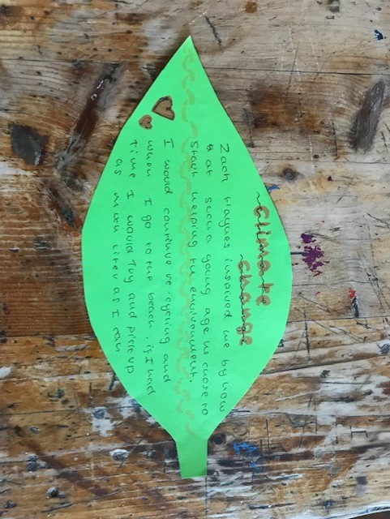
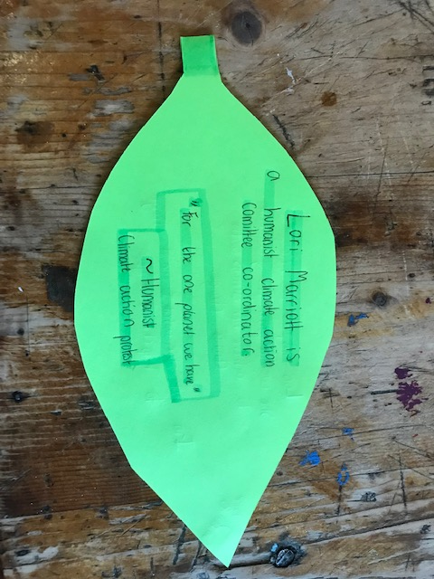
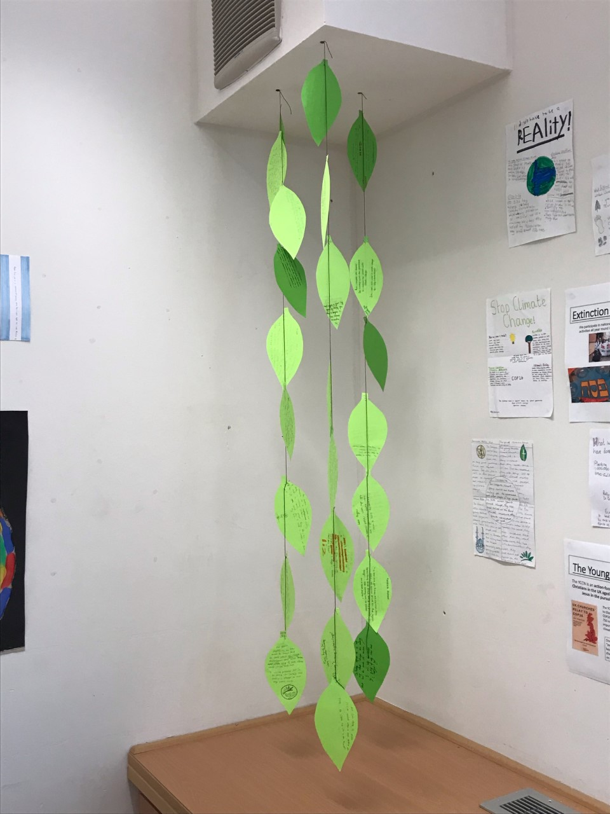
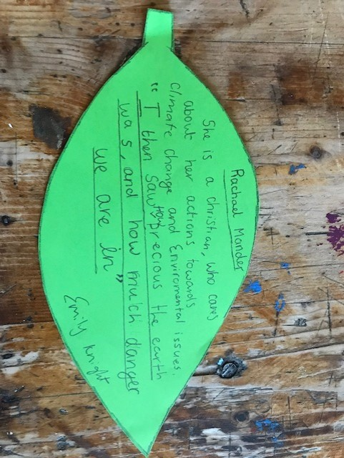
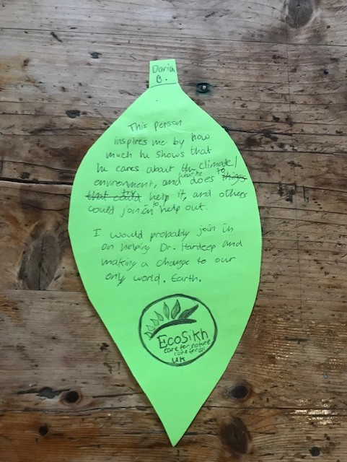
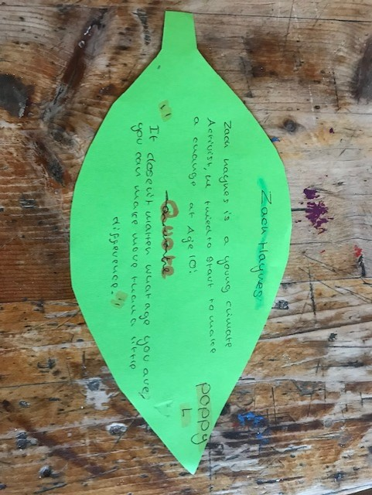
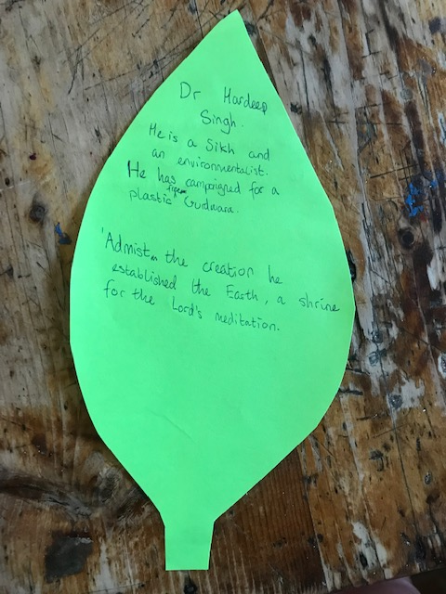

Slide 13
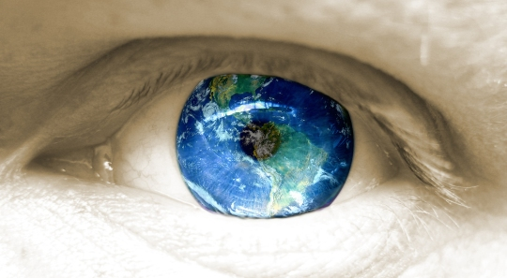
My Climate Story
Where do you stand? – generating ideas
What is their ‘own climate story’?
Creative Response - Triarama
- Art
Poetry
Prose
Opportunity to tell their story
E.g.
Developing thoughts on climate
Response to what we have learnt
Pledges to the earth

Slide 14
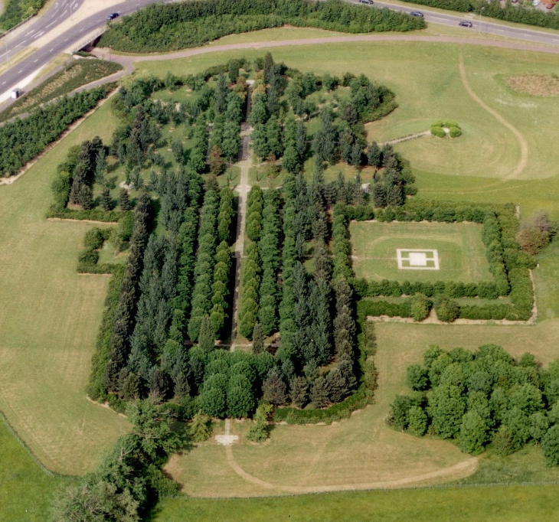
Going forward
Roll out to the whole year group in 2022/23
Depth, rather than breadth?
Longer scheme of work?
Learning outside the classroom?
Application in the school / community?

